Slide 1


Slide 2
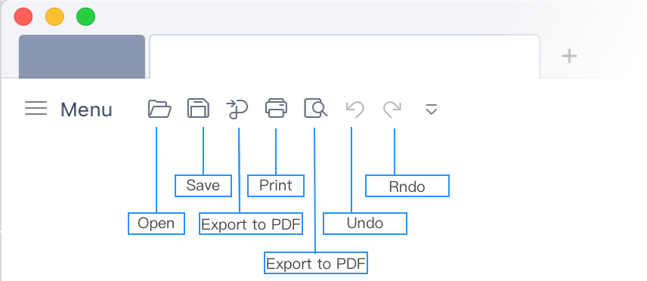
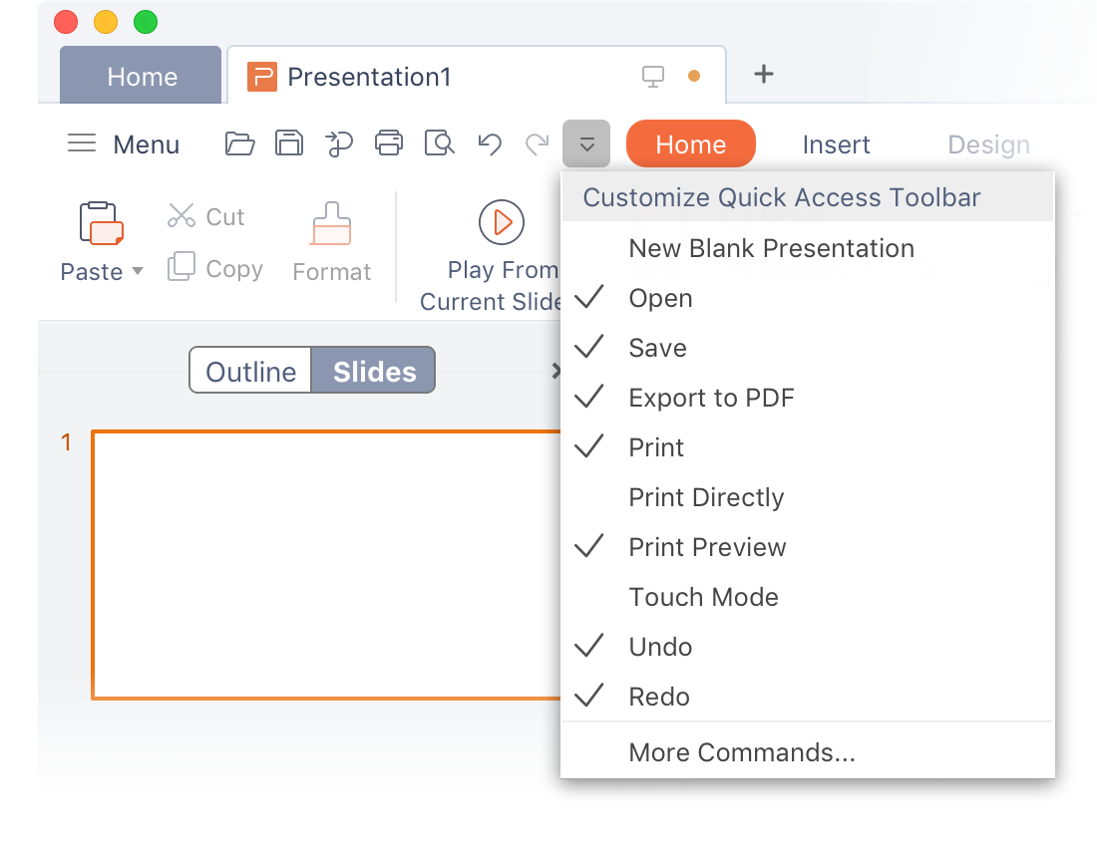
Quick Access Toolbar
You can access commonly used tools in the Quick Access Toolbar at the top of the document simply by clicking on them.
You can customize the Quick Access Toolbar in case the commands you need are not there.To do so, you can:
Select Customize Quick Access Toolbar ,
then select the tool names to add or delete from Quick Access Toolbar

Slide 3
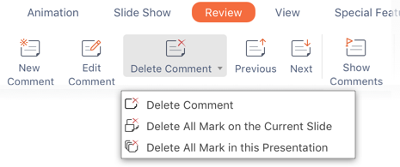



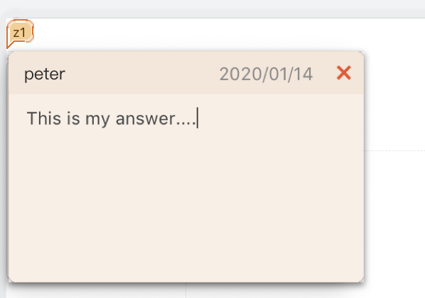

NEW Comment
Comments appear as dialogs, which makes it easier for you to communicate around the contents in the
slide. In this way,you can add your comments more quickly.
To do so, you can:
1. Select any position in the paragraph, then select Review tab.
2. Select New Comment , then type your comments.
3. Select Edit Comment , then type your comments.
4. Select Show Comments ，to show or hide the comments you edited.
5. Select Delete Comment ， to delete your comments.
Tips: To quickly delete all comments in the current slide, select Delete All Mark on the Current Slide in the drop-down box. To quickly delete all comments in the presentation, select Delete All Mark in this Presentation in the drop-down box.

Slide 4
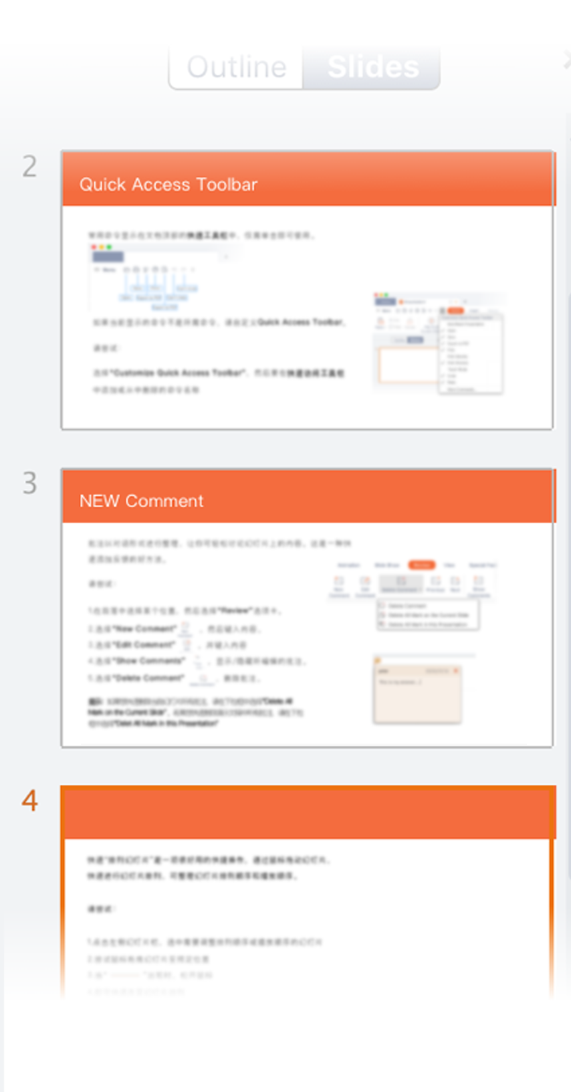
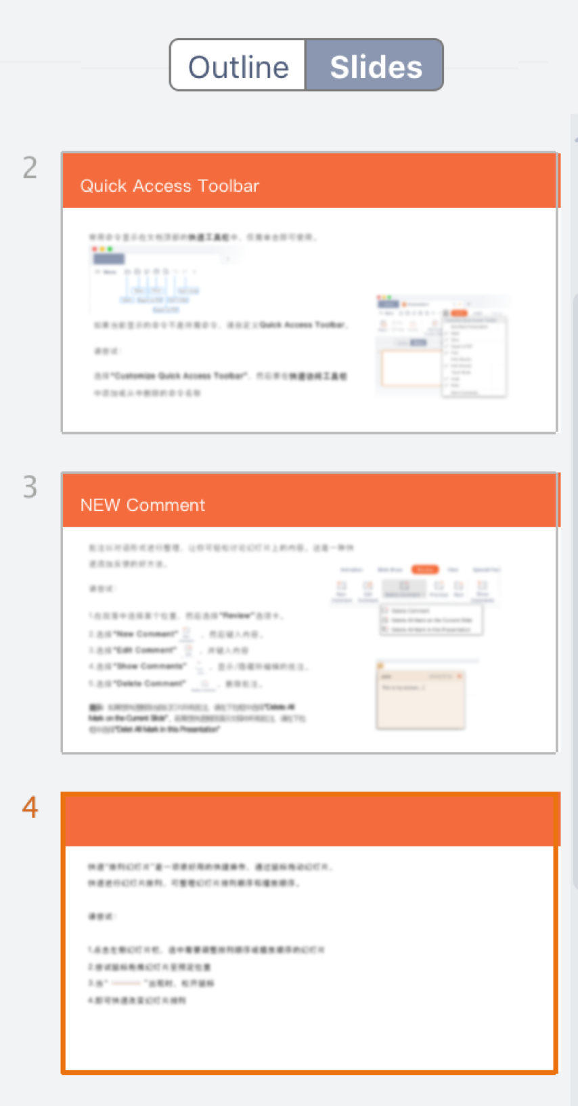
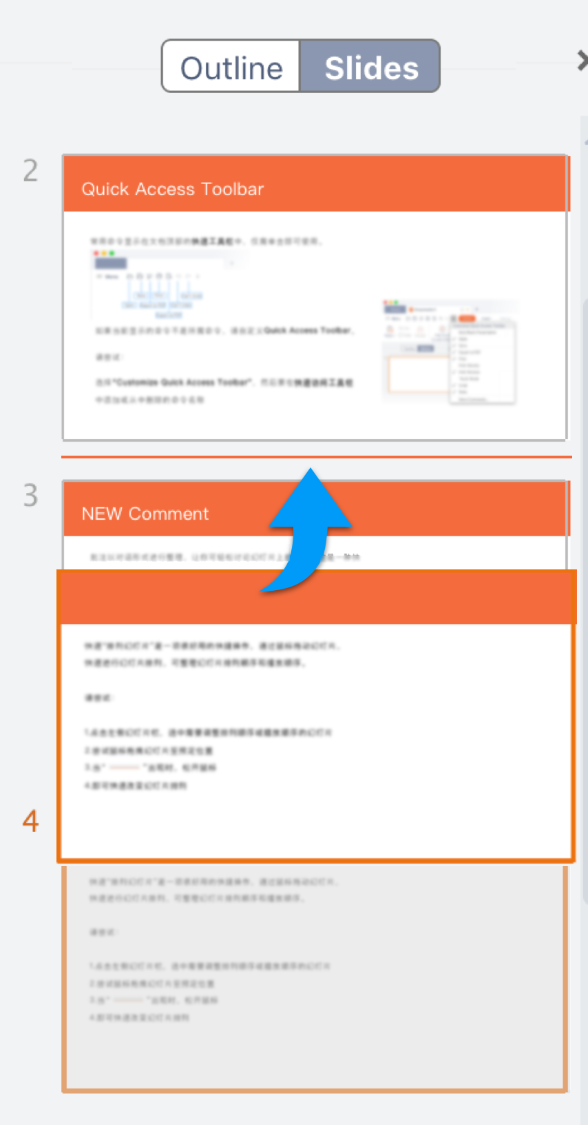
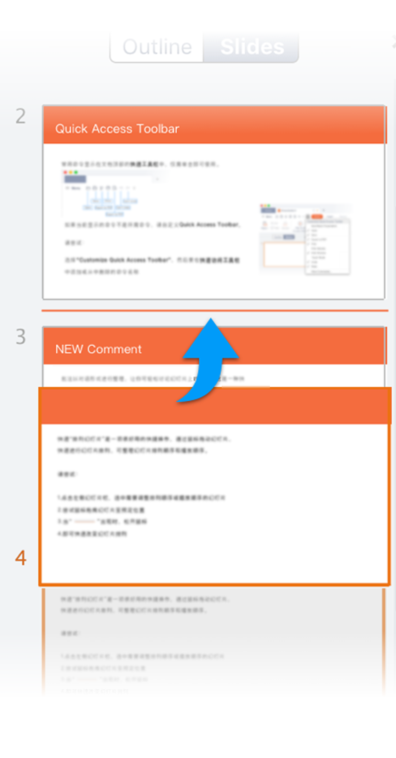
Rearrange Slides
Rearrange Slides is a very useful tool. With it, you can drag and drop the slides with your mouse to rearrange the slides easily and quickly, so that you can change the order of slides for presenting and playback.
To do so, you can:
1. Click on the slide thumbnails bar on the left.
2. Select the slide to rearrange for presenting or playback
3. Drag the slide and drop it to the desired position
4. Release the mouse button to change the order of the slide

Slide 5
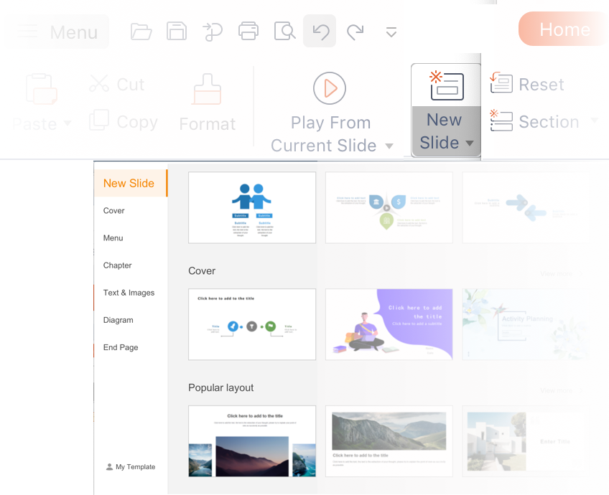
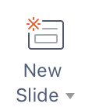


New Template
Usually we are required to use slides to present or make a summary on projects.
How could we make more compelling slides than others? Try our New Template. Our massive collection of
eye-catching templates offer you more opportunities to win in the competitive job market!
To do so, you can:
1. Select New Slide in the Home page, then browse for the templates.
2. Choose a template and click on it to insert.
Tips: To quickly insert a template, select New Slide on the slide bar, then choose your preferred template.

Slide 6
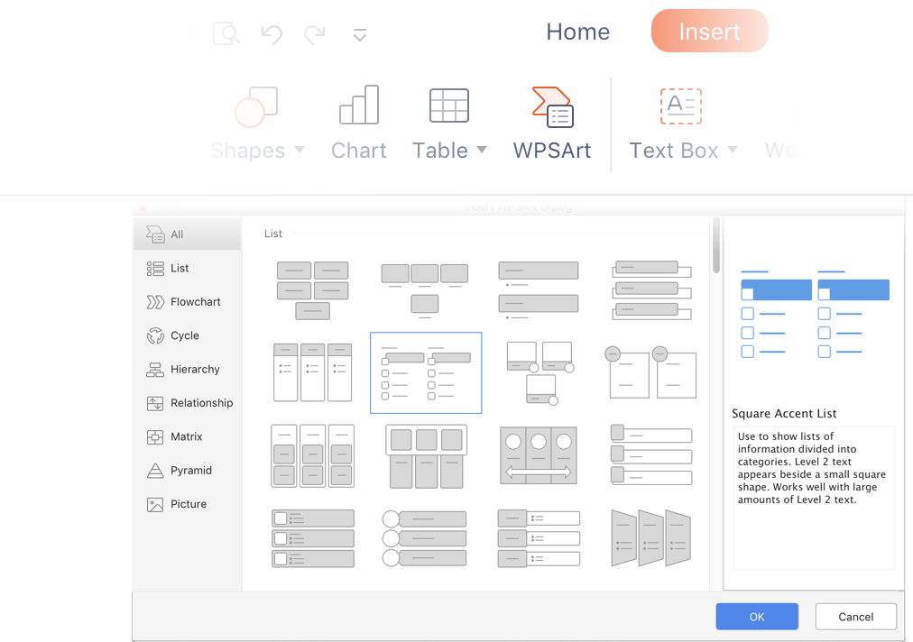
WPS Art
A picture talks more than a thousand words. Pictures can convey the messages in a visual and
straightforward way. Smart Pictures
can provide a graphical presentation of the relationship among messages.
To do so, you can:
1. Go to Insert tab and select WPSArt.
2. Insert a shape in the document: Select your preferred
shape template, then click OK.

Slide 7
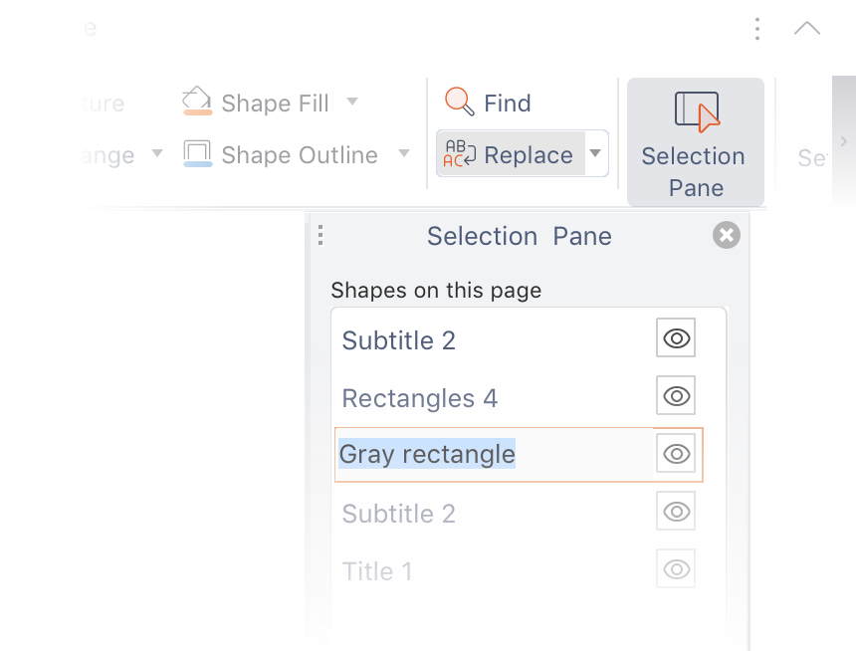

Selection pane
Selection Pane is a great tool for organizing and managing objects like pictures,
shapes, text boxes and so on, on the slides.
To do so, you can:
1. Go to Start tab and select Selection Pane.
2. Rename objects: Double-click the name Gray
rectanglein the Selection Pane and type a new name.
3. Rearrange objects: In the Selection Pane,
drag the large gray rectangle to the top.
4. To turn on/off the visibility of objects in the
Selection Pane,click Show/Hide check box.

Slide 8

Shortcut Keys of WPS Office for Mac
Command - F
Up arrow / Left arrow
Down arrow / Right arrow
Command - Fn -Left - arrow
Command - Fn - Right - arrow
F5
Shift - F5
F7
Command - L
Select All
Find
Replace
Move to the next slide
Move to the first slide
Slide show
From the current slide show
Show Spell check window
Rollback during slide show

